Slide 1
Linear classifiers

Slide 2
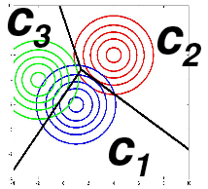
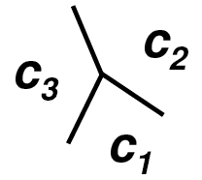
Introduction
Remember that Bayes’ decision rule requires the knowledge of either
P(C_{i}|X) or P(X|C_{i}) and P(C_{i})
We showed how to create an estimate for P(X|C_{i}) using one Gaussian curve or a mixture of Gaussians
We also showed that modeling the distributions implicitly models the discriminant functions as well
  However, in practice we will always have a mismatch
  between the assumed and the real shape of the distribution
  Also, for the classification we don’t need the distributions,
  just the discriminant functions
This gives the idea to model the discriminant functions
directly
  Seems to be an easier problem than estimating distributions

Slide 3
Some naming conventions
Class distribution models
Also called “generative models” (they can be used to generate samples from a class)
More related to the estimation of P(X|C_{i})
Earlier I called this the “decision theoretic approach”
  They require a decision mechanism for classification
Decision surface models
Also called “discriminative models” (they focus on discriminating the classes)
More related to the estimation of P(C_{i}|X)
Earlier I called this the “geometric approach”
  They model the geometry of the decision surface
However, the two classes are not perfectly disjunct, e.g. there are discriminative training methods for GMMs (they optimize the estimate for P(C_{i}|X) instead of P(X|C_{i})…)

Slide 4
Linear classifiers
Today we focus on methods that directly model the discriminant functions
As the simplest case, we will study the case of linear discriminant functions
  We know that they are optimal in the case of Gaussian class distributions with equal covariances
  They may not be optimal for other distributions, but they are very easy to use
While they will perform poor for most practical problems, they will form the basis of two of the best machine learning approaches, neural networks and support vector machines
First, we will discuss the case of having only 2 classes
  Later we will see how to extend the methods to more classes

Slide 5


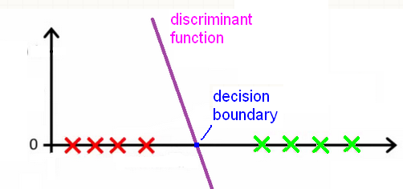
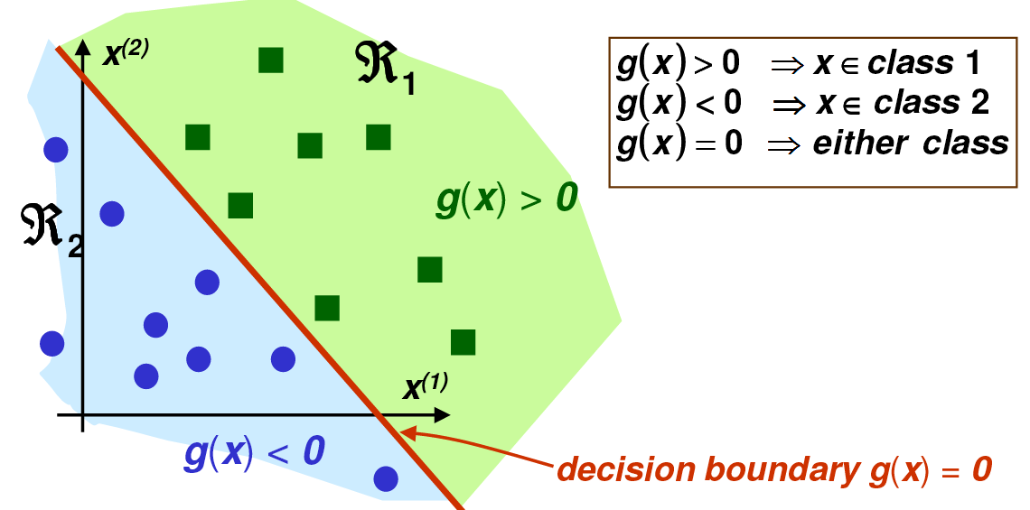
Linear discriminant functions
A discriminant function is called linear if it has the form
  Where w is the weight vector and w₀ is the bias or threshold
The linear discriminant function is a line in 1D, plane in 2D,…
The decision boundary is where
  It is a point in 1D, a line in 2D, a plane in 3D, …

Slide 6
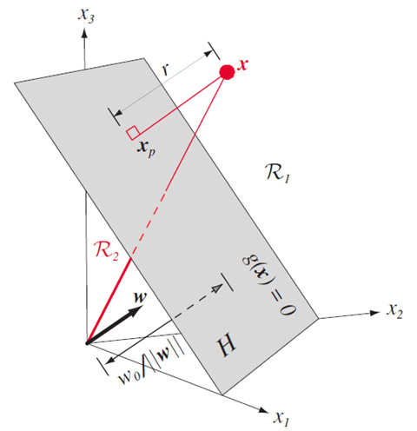

Some coordinate geometry…
w determines the orientation of the decision hyperplane
  It is the normal vector of the plane
w₀ determines the location of the
decision hyperplane
Note that multiplying g(x) by a constant
changes the steepness of the discriminant
function, but won’t change the decision
surface
  So the distance of a point x from the
  decision surface is given by

Slide 7

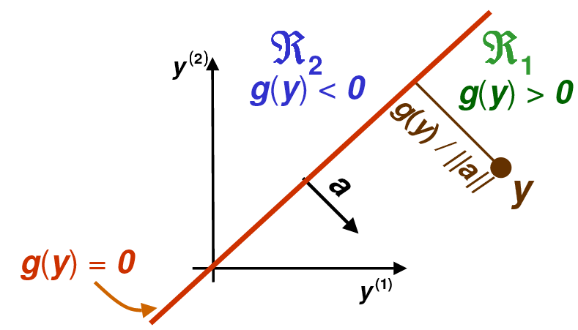
Simplifying the notation
We simplify the notation by fusing w₀ into w
Instead of (w₁, w₂, … w_{d}) we use the weight vector a=(w₀, w₁, w₂, …w_{d})
And we also augment the feature vector as: y=(1, x₁, x₂,…,x_{d})
With this, instead of we can write
So we have a homogeneous
discriminant function
The decision boundary goes
through the origin

Slide 8
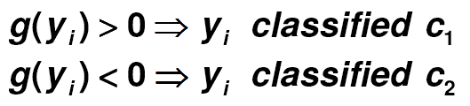
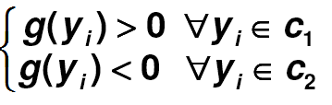
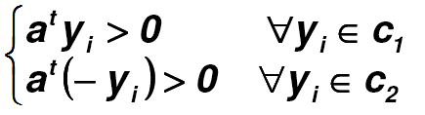


Training the linear classifier
Given samples from c₁ and c₂, how can we select the weight so that the classification error is zero?
Remember that
So the classification error is zero if
Equivalently, the error is zero if
We prefer this form, so we multiply all samples from c₂ by -1
  We call this step the “problem normalization step”
Now we can formalize the goal of training as finding a weight vector a
for which

Slide 9
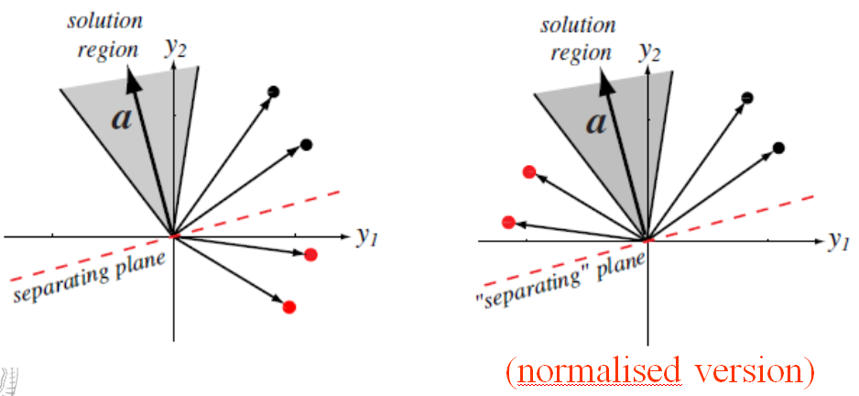
Visualizing the classification problem
All vectors from the shaded region give a good solution
  So usually there is no unique solution, rather a solution region
We seek a hyperplane that separates the samples
We seek a hyperplane that puts the normalized samples on the same side

Slide 10
Training the linear classifier
The goal of training is to find a weight vector a for which
We will examine several methods for this
  The perceptron algorithm will give an iterative solution
  The linear regression method will define an error function
  and solve thins by a closed-form solution
  The gradient descent method optimizes the same error function by an iterative solution
  Then we modify the error function, which leads to the Ho-Kayshap procedure
  Or we can generalize the linear discriminant function, which leads to logistic regression
    This also creates a solution which is related to Bayes’ decision theory!

Slide 11
The perceptron learning rule
Rosenblatt invented the linear classifier as the “perceptron” in 1957
  He also proposed a training method that was called the perceptron learning rule
  He pointed out the similarity of the model to biological neurons
  This was the origin of the “artificial neural network” research field
The perceptron learning rule
  It is an iterative algorithm (goes through the training samples many times)
  If a sample is correctly classified, it does nothing
  If a sample is misclassified, it modifies the weights
  If the 2 classes are linearly separable, then it finds a good solution in finite steps
  However, it guarantees nothing when there is no solution
    This is why we will prefer other methods later

Slide 12
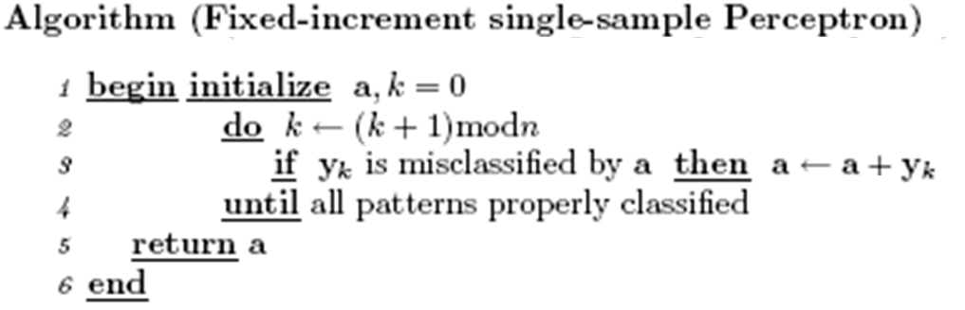


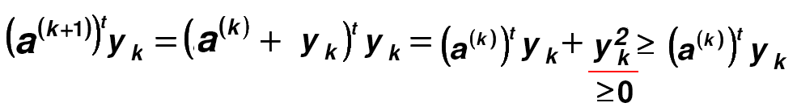
The perceptron learning rule
Proof that it modifies the weights in the good direction:
  Remember that a sample is misclassified if
  In that case, the algorithm updates a:
  Then the output value changes as:

Slide 13
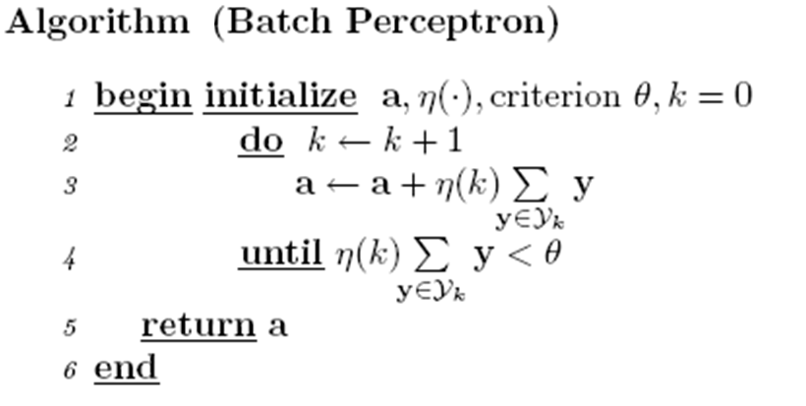
Variants of the perceptron learning rule
The perceptron update rule modifies the weights after each sample
  This is what we call on-line learning
The off-line of batch variant updates the weights using all misclassified samples:
  Where Y_{k} is the set of all misclassified samples
  η(k) is the learning rate (a small positive value, which is constant or gradually decreases as the iteration count k increases)

Slide 14
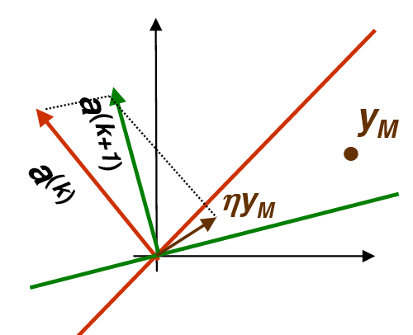
Visualization
Red curve: decision surface before iteration (y is on the wrong side)
Green curve: decision surface after iteration (y is on the proper side)

Slide 15
Training by optimizing a target function
This group of methods requires us to quantify the error of the classifier by some function
  This function is called the error function, cost function, objective function, target function,…
  The parameters of this function will be the weights
We will find a proper set of parameters by optimizing the target function
  This turns the machine learning problem into an optimization problem
  In the simplest case we can find the global optimum by a closed formula
  In more complex cases we will use iterative algorithms
  In the most complex cases these iterative algorithms will guarantee only to find a local optimum, not a global optimum

Slide 16

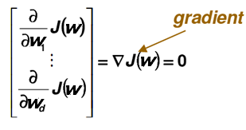
The gradient descent optimization algorithm
The simplest general optimization algorithm for multivariate functions
Suppose that we want to minimize a function of many variables
We know that in the minimum point the derivative is zero
  So, theoretically, we should calculate the partial derivatives and set them to zero
  However, in many practical cases we cannot solve this analytically
The gradient descent algorithm iteratively decreases the target function by stepping in the direction of the steepest decrease, which direction is given by the gradient vector

Slide 17
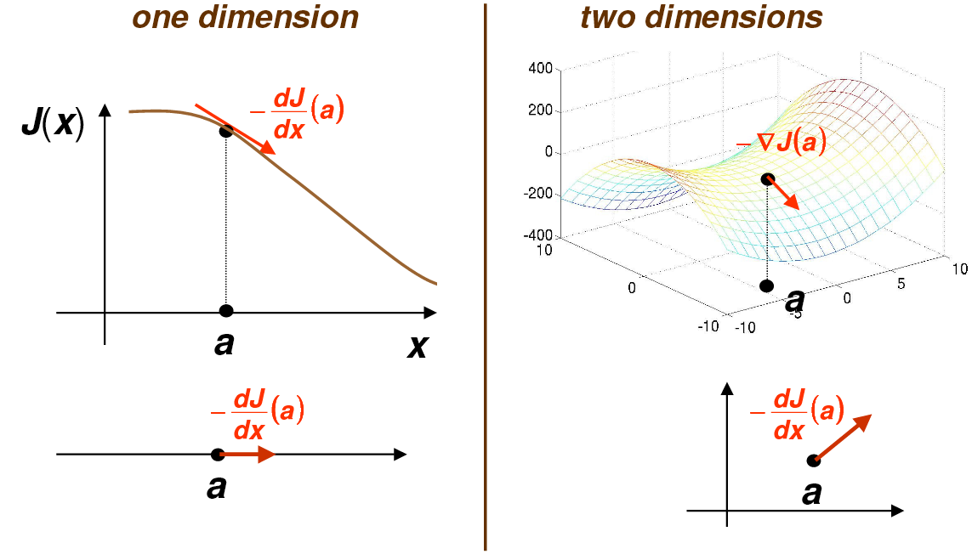
Gradient descent

Slide 18
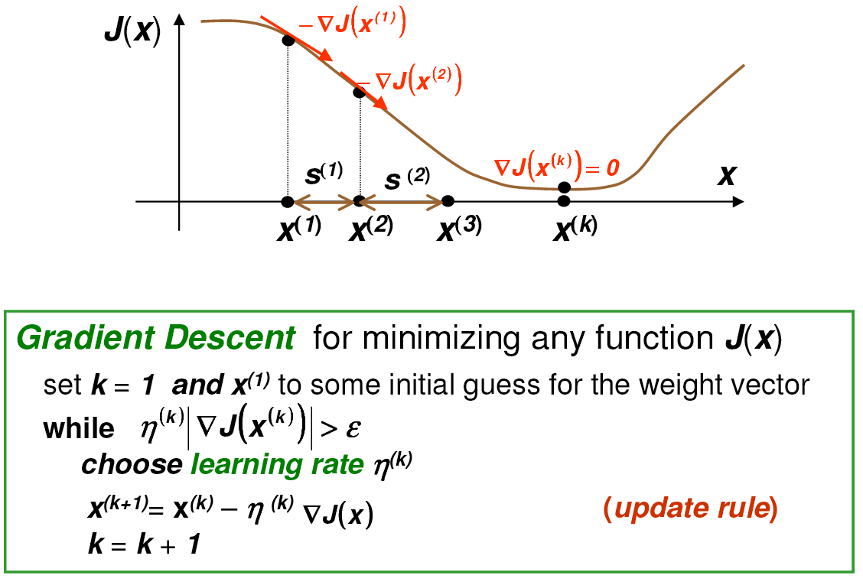
Gradient descent iterations

Slide 19
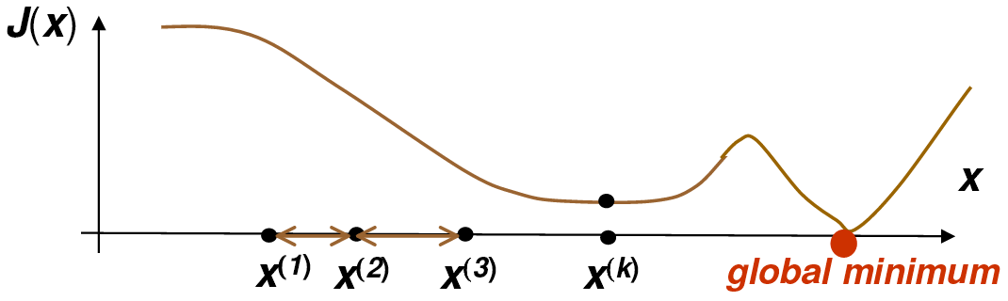
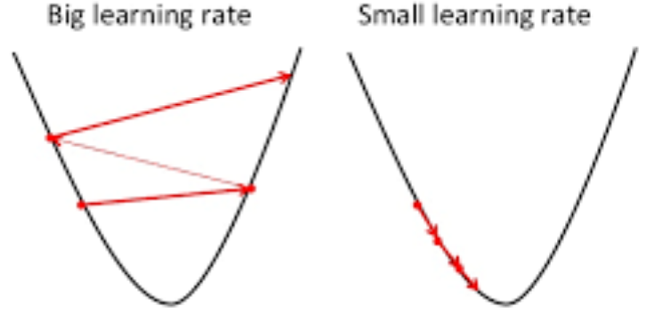
The weaknesses of gradient descent
Gradient descent may stuck in a local optimum
If the learning rate is too small, the algorithm converges too slowly
If the learning rate is too large, we won’t find the optimum
  We usually start with a large learning rate and gradually decrease it

Slide 20
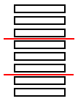
Variants of gradient descent
We usually define the error of the actual model (actual parameter set) as the sum of value of the error function over all samples
  In this case, the gradient descent algorithm is very similar to the off-line or batch version of the perceptron algorithm
However, we can also apply the on-line or semi-batch version of the algorithm – we process the training data in batches
  In this case we calculate the error only over one sample or
  a subset (batch) of the samples before updating the weights
  This version is known as stochastic gradient descent (SGD):
    By calculating the error over a different subset of the samples in each iteration, we
    optimize a slightly different version of the original target function (which is defined as the error over all samples)
    This introduces a slight randomness into the process
    In practice it is not harmful, but in fact helps avoid local optima, and also makes convergence faster

Slide 21

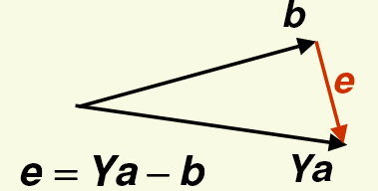
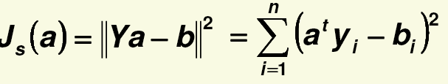

The mean squared error (MSE)
We want to find a weight vector a for which
Let’s define a target value b_{i} for each sample, so that
And define the error of the training as
This is the mean squared error function
And the problem is turned into a regression task
In this case it is a linear task, also known as least squares linear regression
What are good target values for b_{i}?
  The should be positive
  In lack of further information, we can use

Slide 22
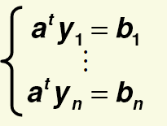
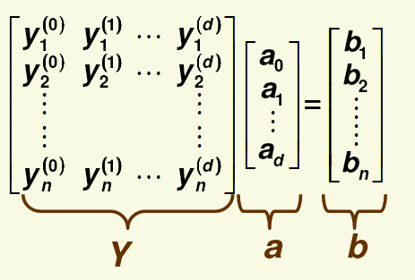

Least squares linear regression
We need to solve n linear equations
In matrix notation:
So, shortly, we have to solve

Slide 23


Least squares linear regression
We need to solve a linear system
where the size of the Y matrix is n times d+1
(n is the number of examples, d is the number of features)
If n=d+1, then Y is a square matrix, and if Y is nonsingular, then there is exactly one solution:
But this rarely happens in practice
Usually the number of examples is much higher than the number of features
In this case the equation system is overdetermined (we have more equations that unknowns), so there is no exact solution
  That is, the MSE error cannot be 0
But we can still find a solution that minimizes the MSE error function

Slide 24
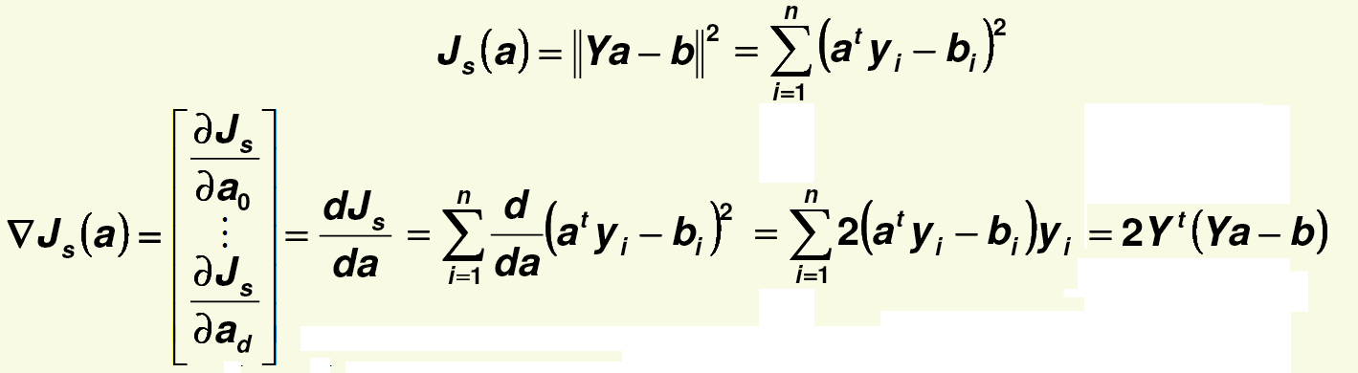



Minimizing the MSE error
We minimize the MSE error by calculating its gradient
Then we set the gradient to zero
If the inverse of Y^{t}Y exists, there is a unique solution
(Y^{t}Y)⁻¹Y^{t} is called the Moore-Penrose pseudo-inverse of Y, because

Slide 25
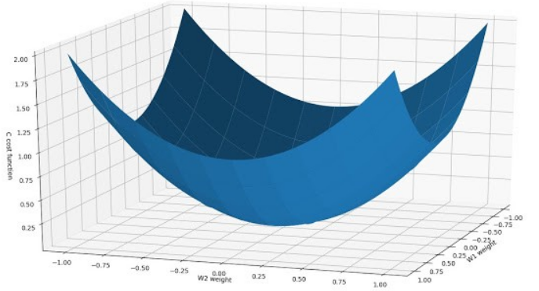
Minimizing the MSE error using gradient descent
We can also use the gradient descent optimization procedure to find the minimum of the MSE error function
  In this case, it is also guaranteed to find the
  global optimum, because the error surface is
  a quadratic bowl, it has no local optima
  (we have to take care to gradually decrease
  the learning rate, though)
Why would we prefer an iterative solution when there is a closed form solution?
  In n or/and d is large, working with the Y matrix may be too costly (matrix multiplication/inversion)
  If Y is close to singular (e.g. some samples are highly correlated) the matrix inversion may become numerically instable

Slide 26
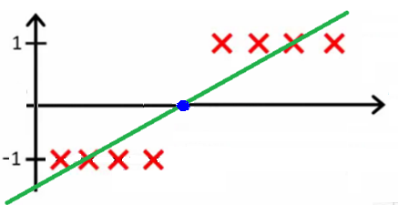
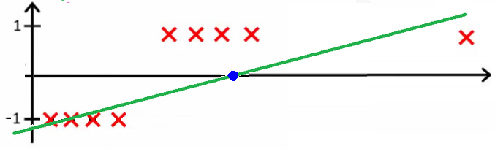
Problems with the least squares linear regression approach
We set the target value to 1 for all positive examples, and to -1 for all negative examples (remember the normalization step!)
  This is what we are trying to do in 1D:
  This is what happens when a sample is too far in the good side:

Slide 27
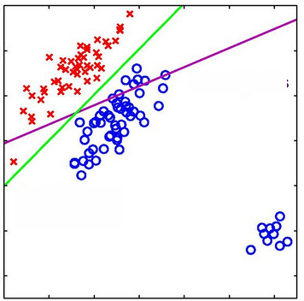
Problems with linear regression
Another example in 2D (showing only the decision surface):
  The algorithm pays too much attention to samples that are far away from the decision surface
Some possible solutions
  Modify the target values → Ho-kashyap procedure
  Modify (generalize) the discriminant function → logistic regression
  Modify the error function → Support vector machines

Slide 28

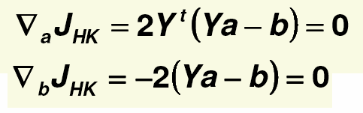
The Ho-Kayshap procedure
The source of the problem is that we used the target value of b=1 for all samples
But in fact, the only requirement is that b>0
The Ho-Kayhsap procedure optimizes the MSE function with respect to both a and b with the condition that b>0
We minimize the error
By iterating two steps until convergence:
  1. Fix b and minimize the error function with respect to a
  2. Fix a and minimize the error function with respect to b
The two derivatives required for this:

Slide 29


The Ho-Kayhsap procedure
Step 1. can be solved by calculating the pseudo-inverse
For Step 2. we could apply
  But it would not guarantee that b is positive
So we will apply the gradient descent rule
But we will take care that no component of b becomes negative!
So we will start with small positive b values, and does not allow any component of b to decrease
This can be achieved by setting all the positive components of the gradient to 0:

Slide 30
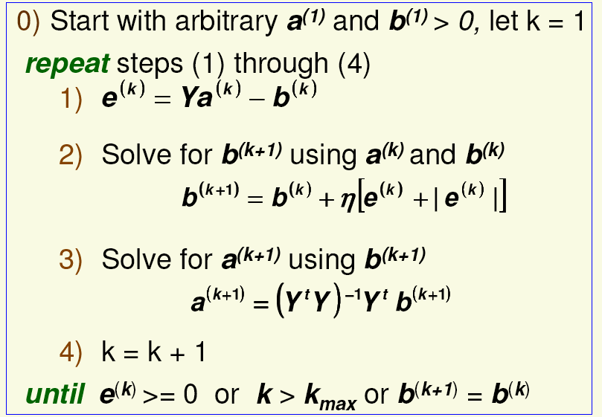
The Ho-Kayhsap procedure
In a linearly separably case, the algorithm continues until at least one component of the error e is >0
  And when e=0, a solution is found, so the algorithms stops
In a linearly non-separable case all components of e become negative, which proves nonseparability (and we also stop)

Slide 31
Logistic regression
Remember what was our problem with linear regression:
Obviously, it makes no sense to force a linear function to take the value of 1 in many points.
The Ho-Kayshap procedure modified the target values. Now we modify the shape of the regression function
  This is how we arrive to logistic regression, which is a special case of generalized linear modeling
  Our new curve will be able to take (approximately) the values of 0 and 1 in many points, this is why it is called a “logistic” function
  Its values can be interpreted as probabilities → Bayes decision theory!

Slide 32
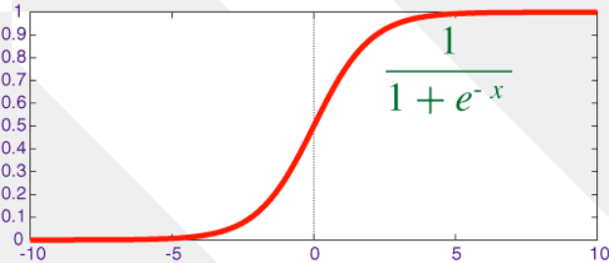

Logistic regression
Instead of using the linear discriminant function directly
We apply the sigmoid function σ over the linear function
So our discriminant function will be

Slide 33
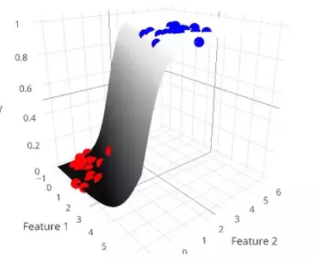
Advantages of logistic regression
The shape of the new discriminant function is more suitable to fit two target values (we will use 0 for class₁ and 1 for class₂)
  Example in 2D:
The output of g(x) is now between 0 and 1, so it van also be interpreted as an estimate for P(C₁|X)
  P(C₁|X)=g(x)
  P(C₂|X)=1-g(x) because P(C₁|X)+P(C₂|X)=1
So choosing the class for which g(x) is larger will now coincide with Bayes’ decision theory!

Slide 34


Maximum likelihood logistic regression
How can we optimize the parameters of g(x)?
To formalize the likelihood of the samples, we introduce the target value t=1 for samples of class₁ and t=0 for samples of class₂
Notice that we want to maximize g(x) for class₁ and 1-g(x) for class₂
So we can formalize the likelihood of the training samples as
  Notice that for each sample only one of the two terms is different from 1
Instead of the likelihood, we will maximize the log-likelihood
Taking it with a negative sign, it is also called the cross-entropy error (the cross-entropy of g(x_{i}) and t_{i})
  So maximizing likelihood is the same as minimizing the cross-entropy

Slide 35

Maximum likelihood logistic regression
We cannot perform the optimization by setting the derivative to zero
  No simple closed-form solution exists
But can perform the maximization by applying gradient descent
  And the error function is convex and has a unique optimum
MSE optimization
  We can also optimize g(x) by using the MSE error function between the targets and the actual output
  Again, no close-from solution exists, but we can minimize this error function by calculating the gradient and applying gradient descent
  But the error function is not convex in this case
  This is why the cross-entropy error function is preferred in practice

Slide 36
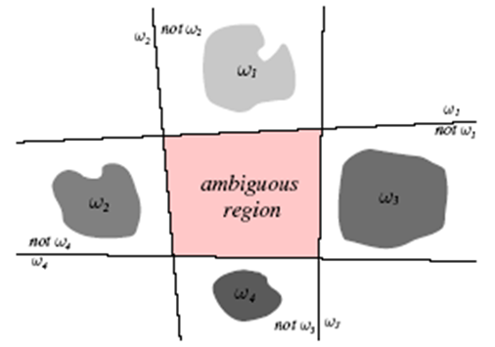
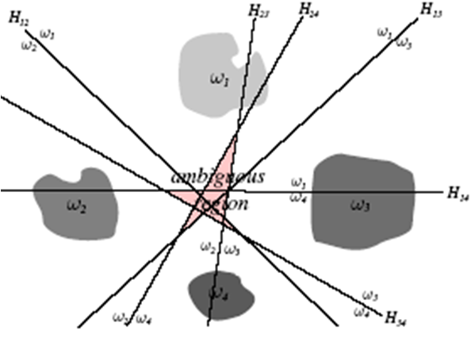
Multiple classes
Obviously, one linear decision boundary can separate only two classes
So, to separate m classes we need more than one linear classifiers
How can we separate m classes with linear decision boundaries?
1. strategy: one against the rest 2. strategy: one against another
(m decision boundaries) (m(m-1)/2 decision boundaries)
Both solutions may result in ambiguous regions

Slide 37

The linear machine
Suppose we have m classes
Let’s define m linear discriminant functions
And classify a random sample x according to the maximum:
Such a classifier is called the linear machine
A linear machine divides the feature space into m decision regions, where g_{i}(x) is the largest discriminant in region R_{i}
The maximum decision rule solves the problem of the ambiguous regions, as the maximum is defined in all points of the feature space

Slide 38
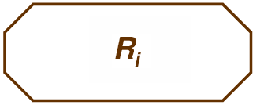

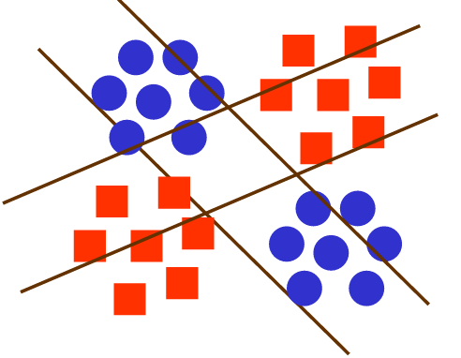
Decision regions for the linear machine
The decision regions defined by the linear machine are convex and contiguous
  So this is a possible region:
  But this is not possible:
  We won’t be able to solve problems like this:
  Obviously, the capabilities of a linear machines
  is rather limited. We will see two quite different
  solutions to this in the SVM and the neural
  network method

Slide 39
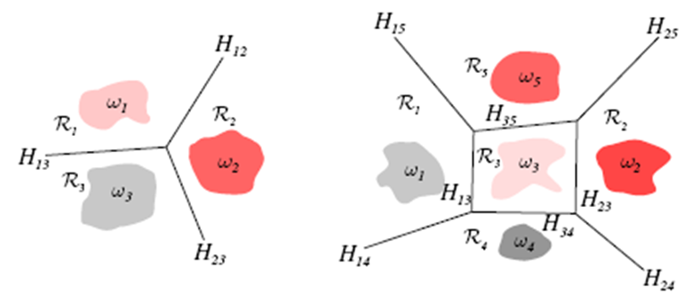
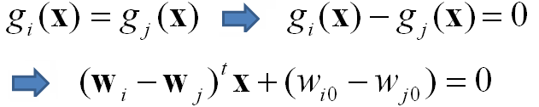
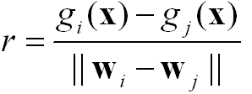
Decision regions for the linear machine
Two examples for the decision regions of a linear machine
The decision boundary between two adjacent classes will be defined by
The normal vector of H_{ij} is (w_{i}-w_{j}) and signed distance from x to H_{ij} is

Slide 40
Training the linear machine
The linear machine has m linear discriminant functions
We can optimize the weights of each of these functions to separate the actual class from all the other classes (“one against the rest” approach)
This way, we reduced the m-class classification problem to m 2-class problems
Each of these linear classifiers can be trained separately, by considering the samples of the actual class as class₁ and all the other samples as class₂
Any of the previously discussed methods can be used for this
But in the case of logistic regression there is a better solution called multiclass logistic regression

Slide 41

Multiclass logistic regression
Similar to logistic regression for 2 classes, we can modify the linear regression function to a function that returns non-negative values between 0 and 1, and the outputs add up to one
  This way the outputs can be interpreted as posterior probabilities P(C_{k}|X)
We will use the softmax function for this (k is the class index):
Let’s define the target vector t_{i}=(0, 0, …, 1, 0, 0) where there is only one 1 at the kth position, where k is the class of the ith sample
  This is known as “1-of-K” coding

Slide 42


Multiclass logistic regression
Using the 1-of-K target vector, we can formalize the likelihood as:
  Notice that for each x_{i} vector only one of the K terms is different from 1!
Taking the negative of the logarithm (with a minus sign), we obtain the cross-entropy error function for multiple classes
  Notice that again only 1 component is different from 0, which is the component that belongs to the correct class
Similar to the two-class case, we can perform the optimization by calculating the derivative and applying gradient descent

